Slide 1

Unit-3 Mining Frequent Patterns, Associations, and Correlations
Data Mining (DM)
2101CS521
Prof. Jayesh D. vagadiya
Computer Engineering Department
jayesh.vagadiya@darshan.ac.in
9537133260

Slide 2

Looping
Topics to be covered
What Kinds of Patterns Can Be Mined?
Market Basket Analysis
Frequent Itemsets
Association Rule
Maximal and Closed Frequent Itemsets
Apriori Algorithm
Methods to Improve Apriori Efficiency
FP-growth Algorithm
Correlation

Slide 3
What Kinds of Patterns Can Be Mined?
Data mining functionalities can be classified into two categories:
Descriptive
Predictive
Descriptive
This task presents the general properties of data stored in a database.
The descriptive tasks are used to find out patterns in data.
E.g.: Frequent patterns, association, correlation etc.
Predictive
These tasks predict the value of one attribute on the basis of values of other attributes.
E.g.: Festival Customer/Product Sell prediction at store
We are going to cover this part in this chapter

Slide 4
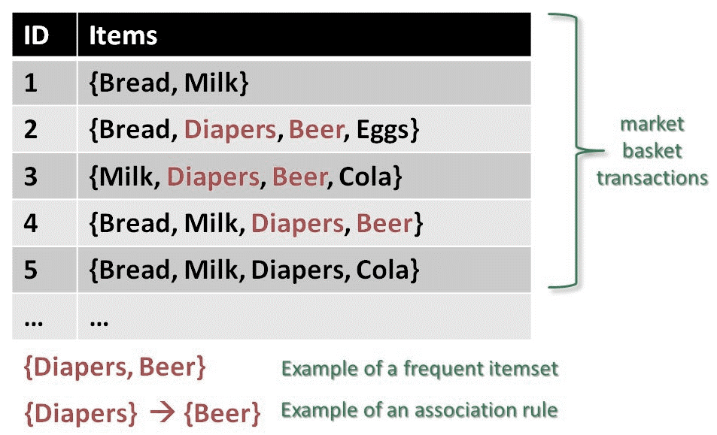
What Kinds of Patterns Can Be Mined?
Mining Frequent Patterns:
Frequent patterns are those patterns that occur frequently in data. Here is the list of kind of frequent patterns
Frequent Item Set
It refers to a set of items that frequently appear together, for example, milk and bread.
Frequent Subsequence
A sequence of patterns that occur frequently such as purchasing a laptop is followed by digital camera and a memory card.
Frequent Sub Structure
A substructure can refer to different structural forms (e.g., graphs, trees, or lattices) that may be combined with itemset or subsequence's.

Slide 5

Market Basket Analysis
Market Basket Analysis is a modelling technique to find frequent itemset.
It is based on, if you buy a certain group of items, you are more (or less) likely to buy another group of items.
For example, if you are in a store and you buy a car then you are more likely to buy insurance at the same time than somebody who don't buy insurance also.
The set of items that a customer buys it referred as an itemset.
Market basket analysis seeks to find relationships between purchases (Items).
E.g. IF {Car, Accessories} THEN {Insurance}
{Car, Accessories} → {Insurance}

Slide 6
Association Rule
The process of uncovering the relationship among data and determining association rules.
It is used to discover interesting relationships and associations among items or events in large datasets.
Computer
Software
IF
then

Slide 7
Association Rule Mining
Given a set of transactions, we need rules that will predict the occurrence of an item based on the occurrences of other items in the transaction.
Market-Basket transactions
TID | Items
1 | Bread, Milk
2 | Bread, Chocolate, Pepsi, Eggs
3 | Milk, Chocolate, Pepsi, Coke
4 | Bread, Milk, Chocolate, Pepsi
5 | Bread, Milk, Chocolate, Coke
Example of Association Rules
{Chocolate} → {Pepsi},
{Milk, Bread} → {Eggs, Coke},
{Pepsi, Bread} → {Milk}

Slide 8
Association Rule Mining Cont..
Itemset
A collection of one or more items
E.g. : {Milk, Bread, Chocolate}
k-itemset
An itemset that contains k items
Support count (σ)
Frequency of occurrence of an itemset
E.g. σ({Milk, Bread, Chocolate}) = 2
Support
Fraction of transactions that contain an itemset
E.g. s({Milk, Bread, Chocolate}) = 2/5
Frequent Itemset
An itemset whose support is greater than or equal to a minimum support threshold
TID | Items
1 | Bread, Milk
2 | Bread, Chocolate, Pepsi, Eggs
3 | Milk, Chocolate, Pepsi, Coke
4 | Bread, Milk, Chocolate, Pepsi
5 | Bread, Milk, Chocolate, Coke

Slide 9
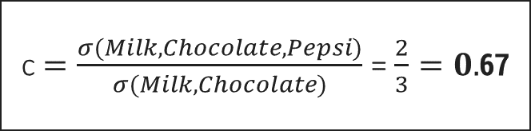
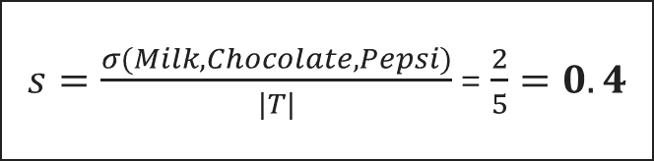
Association Rule Mining Cont..
Association Rule
An implication expression of the form X → Y, where X and Y are
item sets
E.g.: {Milk, Chocolate} → {Pepsi}
Rule Evaluation
Support (s)
Fraction of transactions that contain both X and Y
Confidence (c)
Measures how often items in Y appear in transactions that contain X
TID | Items
1 | Bread, Milk
2 | Bread, Chocolate, Pepsi, Eggs
3 | Milk, Chocolate, Pepsi, Coke
4 | Bread, Milk, Chocolate, Pepsi
5 | Bread, Milk, Chocolate, Coke
Example:
Find support & confidence for {Milk, Chocolate} ⇒ Pepsi
$s=\frac{σ(Milk, Chocolate, Pepsi)}{|T|}$ = $\frac{2}{5}=0.4$
c $=\frac{σ(Milk, Chocolate, Pepsi)}{σ(Milk, Chocolate)}$ = $\frac{2}{3}=0.$67

Slide 10
Association Rule Mining Cont..
A common strategy adopted by many association rule mining algorithms is to decompose the problem into two major subtasks:
Frequent Itemset Generation
The objective is to find all the item-sets that satisfy the minimum support threshold.
These item sets are called frequent item sets.
Rule Generation
The objective is to extract all the high-confidence rules from the frequent item sets found in the previous step.
These rules are called strong rules.

Slide 11
Maximal and Closed Frequent Itemsets
Closed Frequent Itemsets:
A frequent itemset is closed, when no (immediate) superset has the same support.
Maximal Frequent Itemsets:
A frequent itemset is maximal, if none of its (immediate) supersets is frequent.
Frequent Itemsets
Closed Frequent Itemsets
Maximal Frequent Itemsets

Slide 12
Maximal and Closed Frequent Itemsets
Minimum Support = 3
TID | Items
1 | A B C E
2 | A C D E
3 | B C E
4 | A C D E
5 | C D E
6 | A D E
{A} = 4 ; not closed due to {A,E}
{B} = 2 ; not frequent => ignore
{C} = 5 ; not closed due to {C,E}
{D} = 4 ; not closed due to {D,E}, but not maximal due to e.g. {A,D}
{E} = 6 ; closed, but not maximal due to e.g. {D,E}
{A,B} = 1; not frequent => ignore
{A,C} = 3; not closed due to {A,C,E}
{A,D} = 3; not closed due to {A,D,E}
{A,E} = 4; closed, but not maximal due to {A,D,E}
{B,C} = 2; not frequent => ignore
{B,D} = 0; not frequent => ignore
{B,E} = 2; not frequent => ignore
{C,D} = 3; not closed due to {C,D,E}
{C,E} = 5; closed, but not maximal due to {C,D,E}
{D,E} = 4; closed, but not maximal due to {A,D,E}
{A,B,C} = 1; not frequent => ignore
{A,B,D} = 0; not frequent => ignore
{A,B,E} = 1; not frequent => ignore
{A,C,D} = 2; not frequent => ignore
{A,C,E} = 3; maximal frequent
{A,D,E} = 3; maximal frequent
{B,C,D} = 0; not frequent => ignore
{B,C,E} = 2; not frequent => ignore
{C,D,E} = 3; maximal frequent
{A,B,C,D} = 0; not frequent => ignore
{A,B,C,E} = 1; not frequent => ignore
{B,C,D,E} = 0; not frequent => ignore

Slide 13
Apriori Algorithm
It is used to mine frequent patterns.
The algorithm makes use of prior knowledge about frequent item sets to efficiently explore and generate larger item sets.
Apriori employs an iterative approach known as a level-wise search, where k-itemsets are used to explore (k + 1)-itemsets.
First, the set of frequent 1-itemsets is found by scanning the database to accumulate the count for each item, and collecting those items that satisfy minimum support.
The resulting set is denoted by L1. Next, L1 is used to find L2, the set of frequent 2-itemsets, which is used to find L3, and so on, until no more frequent k-itemsets can be found.

Slide 14


Apriori Algorithm - Example
Minimum Support = 2
ItemSet | Min. Sup
{1} | 2
{2} | 3
{3} | 3
{4} | 1
{5} | 3
C₂
ItemSet
{1 2}
{1 3}
{1 5}
{2 3}
{2 5}
{3 5}
TID | Items
100 | 1 3 4
200 | 2 3 5
300 | 1 2 3 5
400 | 2 5
C₁
L₁
ItemSet | Min. Sup
{1} | 2
{2} | 3
{3} | 3
{5} | 3
Scan D
L₂
ItemSet | Min. Sup
{1 3} | 2
{2 3} | 2
{2 5} | 3
{3 5} | 2
C₂
ItemSet | Min. Sup
{1 2} | 1
{1 3} | 2
{1 5} | 1
{2 3} | 2
{2 5} | 3
{3 5} | 2
ItemSet | Min. Sup
{1 2 3} | 1
{1 3 5} | 1
{2 3 5} | 2
Scan D
Scan D

Slide 15
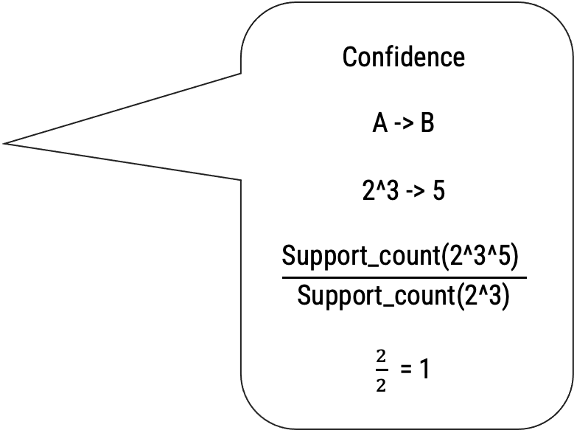
Apriori Algorithm - Example Cont..
Minimum Support = 2
Rules Generation
Confidence
A -> B
2^3 -> 5
$$\frac{\text{Support}\text{_}\text{count}\text{(2^3^5) }}{\text{Support}\text{_}\text{count}\text{(2^3)}}$$
$\frac{2}{2}$ = 1
Association Rule | Support | Confidence | Confidence (%)
2 ^ 3 → 5 | 2 | 2/2 = 1 | 100 %
3 ^ 5 → 2 | 2 | 2/2 = 1 | 100 %
2 ^ 5 → 3 | 2 | 2/3 = 0.66 | 66%
2 → 3 ^ 5 | 2 | 2/3 = 0.66 | 66%
3 → 2 ^ 5 | 2 | 2/3 = 0.66 | 66%
5 → 2 ^ 3 | 2 | 2/3 = 0.66 | 66%

Slide 16
Apriori Property
All nonempty subsets of a frequent itemset must also be frequent.
E.g. if {AB} is a frequent itemset, both {A} and {B} should be a frequent itemset.
This property belongs to a special category of properties called antimonotonicity in the sense that if a set cannot pass a test, all of its supersets will fail the same test as well.
It is used in apriori algorithm to improve the performance of algorithm.

Slide 17
Important steps in Apriori
The Join Step:
Create candidate k-item sets by joining frequent (k-1)-item sets with itself.
C_{k} is generated by joining L_{k-1}with itself.
The join, L_{k−1} I L_{k−1}, is performed, where members of L_{k−1} are joinable if their first (k − 2) items are in common.
The Pruning Step:
Any (k-1) itemset that is not frequent cannot be a subset of a frequent k-itemset.(Apriori property)
Hence, if any (k − 1)-subset of a candidate k-itemset is not in L_{k−1}, then the candidate cannot be frequent either and so can be removed from Ck.
This steps improve the performance by removing the candidate from Ck.

Slide 18
Apriori Algorithm Steps
INPUT:
# D, a database of transactions;
# min_support, the minimum support count threshold.
Algorithm:
C_{k}: Candidate itemset of size k
L_{k}: Frequent itemset of size k
L₁= {frequent items};
for (k = 1; L_{k} != ∅; k++) do begin
C_{k+1} = candidates generated from L_{k} //Join Step
Any (k-1) itemset that is not frequent cannot be a subset of a frequent k- itemset. // Pruning Step
for each transaction t in database do
Increment the count of all candidates in C_{k+1} That are contained in t
L_{k+1} = candidates in C_{k+1} with min_support
end
return L_{k};

Slide 19
Apriori steps
1- Frequent
C1
Apply min_support
L1
Self Join and Pruning
2- Frequent
C2
Apply min_support
L2
Self Join and Pruning
3- Frequent
C3
Apply min_support
L3
N- Frequent

Slide 20
Methods to Improve Apriori Efficiency
Hash-based technique:
Using a hash-based structure known as a hash table, the k-itemsets and their related counts are generated.
The table is generated using a hash function.
For example, when scanning each transaction in the database to generate the frequent 1-itemsets, L1, we can generate all the 2-itemsets for each transaction and hash (i.e., map) them into the different buckets of a hash table structure, and increase the corresponding bucket counts.
TID | Items
1 | 11, 12, 15
2 | 12, 14
3 | 12, 13
4 | 11, 12, 14
5 | 11,13
6 | 12, 13
7 | 11,13
8 | 11, 12, 13, 15
9 | 11, 12, 13
Items | Support Count
I1 | 6
I2 | 7
I3 | 6
I4 | 2
I5 | 2
C1

Slide 21
Methods to Improve Apriori Efficiency
Hash-based technique:
Hash Table Structure to generate L2
Itemset | Count | Hash Function
11, 12 | 4 | [1*10+2] mod 7=5
11,13 | 4 | [1*10+3] mod 7=6
11, 14 | 1 | [1*10+4] mod 7=0
11, 15 | 2 | [1*10+5 mod 7=1
12, 13 | 4 | [2*10+3] mod 7=2
12, 14 | 2 | [2*10+4] mod 7=3
12, 15 | 2 | [2*10+5] mod 7=4
13, 14 | 0 | -
13, 15 | 1 | [3*10+5] mod 7=0
14, 15 | 0 | -
Bucket address | 0 | 1 | 2 | 3 | 4 | 5 | 6
Bucket Count | 2 | 2 | 4 | 2 | 2 | 4 | 4
Bucket Content | {I1,I4:1} {I3,I5:1} | {I1,I5:2} | {I2,I3:4} | {I2,I4:2} | {I2,I5:2} | {I1,I2:4} | {I1,I5:4}
L2 | NO | NO | YES | NO | NO | YES | YES
Hash Function
H(X, Y)= ((Order of First)* 10+(Order of Second))mod 7

Slide 22
Methods to Improve Apriori Efficiency
Transaction reduction:
A transaction that does not contain any frequent k-itemsets cannot contain any frequent (k + 1)-itemsets.
Therefore, such a transaction can be marked or removed.
During this step, the algorithm further reduces the size of transactions by eliminating items that are no longer frequent after the previous iteration.
Since the eliminated items can't be part of any frequent itemsets, removing them reduces the search space and improves efficiency.

Slide 23
Methods to Improve Apriori Efficiency
Partitioning:
It consists of two phases.
In phase I, the algorithm divides the transactions of D into n nonoverlapping partitions.
Find the frequent itemsets local to each partition (1 scan).
Combine all local frequent itemsets to form candidate itemset.
In phase II, Find global frequent itemsets among candidates (2 scan) and we get Frequent itemsets in D
Phase - I
Phase - II
Trans.
in D
Divide D
into n
Non-
over lapping
partitions
Find frequent
itemsets local
to each
partition
(parallel alg.)
Combine
results to
form a global
set of
candidate
itemset
Find global
frequent
itemsets
among
candidates
Freq.
itemsets
in D

Slide 24
Methods to Improve Apriori Efficiency
Sampling:
A random sample S is selected from database D, and then a search is conducted for frequent itemsets within that sample S.
In this way, we trade off some degree of accuracy against efficiency.
These frequent itemsets are called sample frequent itemsets.
More than one sample could be used to improve accuracy.

Slide 25
Methods to Improve Apriori Efficiency
Dynamic itemset counting:
Dynamic itemset counting refers to the process of incrementally updating the support counts of itemsets as new transactions are added to the dataset.
This is particularly useful when dealing with dynamic or streaming data where transactions arrive over time.
Instead of recalculating support counts from scratch whenever new data arrives, dynamic counting efficiently maintains and updates the support counts of existing itemsets.
The technique uses the count-so-far as the lower bound of the actual count.
If the count-so-far passes the minimum support, the itemset is added into the frequent itemset collection and can be used to generate longer candidates.

Slide 26
Disadvantages of Apriori
It may still need to generate a huge number of candidate sets.
For example, if there are 10⁴ frequent 1-itemsets, the Apriori algorithm will need to generate more than 10⁷ candidate 2-itemsets.
it may need to repeatedly scan the whole database and check a large set of candidates by pattern matching.
It is costly to go over each transaction in the database to determine the support of the candidate itemsets.

Slide 27
Apriori Algorithm (Try Yourself!)
A database has 4 transactions. Let Min_sup = 50% and Min_conf = 75%
TID | Items
1000 | Cheese, Milk, Cookies
2000 | Butter, Milk, Bread
3000 | Cheese, Butter, Milk, Bread
4000 | Butter, Bread
Frequent Itemset | Sup
Butter,Milk,Bread | 2
Sr. | Association Rule | Support | Confidence | Confidence (%)
Rule 1 | Butter^Milk → Bread | 2 | 2/2 = 1 | 100%
Rule 2 | Milk^Bread → Butter | 2 | 2/2 = 1 | 100%
Rule 3 | Butter^Bread → Milk | 2 | 2/3 = 0.66 | 66%
Rule 4 | Butter→Milk^Bread | 2 | 2/3 = 0.66 | 66%
Rule 5 | Milk→Butter^Bread | 2 | 2/3 = 0.66 | 66%
Rule 6 | Bread→Butter^Milk | 2 | 2/3 = 0.66 | 66%
Min_sup = 50%
How to convert support in integer?
Given % X Total Records
100
So here, 50 X 4
100
= 2

Slide 28
FP-growth
It stands for finding frequent item sets without candidate generation.
First, it compresses the database representing frequent items into a frequent pattern tree or FP tree.
Once an FP-tree has been constructed, it uses a recursive divide-and-conquer approach to mine the frequent item sets.

Slide 29
FP-growth Example
Minimum Support = 3
FP-Tree Generation
Step:1
Freq. 1-Itemsets.
Min_Sup ≥ 3
Step:2
Transactions with items sorted based on frequencies, and ignoring the infrequent items.
TID | Items
1 | E K M N O Y
2 | D E K N O Y
3 | A E K M
4 | C K M U Y
5 | C E I K O
item | Frequency
A | 1
C | 2
D | 1
E | 4
I | 1
K | 5
M | 3
N | 2
O | 3
U | 1
Y | 3
{K:5, E:4, O:3, M:3, Y:3}
Building the FP-Tree
Scan data to determine the support count of each item.
Infrequent items are discarded, while the frequent items are sorted in decreasing support counts.
Make a second pass over the data to construct the FP­-tree.
As the transactions are read, before being processed, their items are sorted according to the above order.
TID | Sorted Items
1 | K E M O Y
2 | K E O Y
3 | K E M
4 | K M Y
5 | K E O

Slide 30
FP-growth Example
K E M O Y
K E O Y
K E M
K M Y
K E O
null
K:1
E:1
K:5
E:4
M:3
O:3
Y:3
M:1
O:1
Y:1

Slide 31
FP-growth Example
K E M O Y
K E O Y
K E M
K M Y
K E O
null
K:2
E:2
K:5
E:4
M:3
O:3
Y:3
M:1
O:1
O:1
Y:1
Y:1

Slide 32
FP-growth Example
K E M O Y
K E O Y
K E M
K M Y
K E O
null
K:3
E:3
K:5
E:4
M:3
O:3
Y:3
M:2
O:1
O:1
Y:1
Y:1

Slide 33
FP-growth Example
K E M O Y
K E O Y
K E M
K M Y
K E O
null
K:4
E:3
K:5
E:4
M:3
O:3
Y:3
M:2
M:1
O:1
O:1
Y:1
Y:1
Y:1

Slide 34
FP-growth Example
K E M O Y
K E O Y
K E M
K M Y
K E O
null
K:5
E:4
K:5
E:4
M:3
O:3
Y:3
M:2
M:1
O:1
O:2
Y:1
Y:1
Y:1

Slide 35
FP-growth Example
Conditional Pattern Base
null
K:5
Item | Conditional Pattern Base
Y | {KEMO:1} {KEO:1} {KM:1}
O | {KEM:1} {KE:2}
M | {KE:2} {K:1}
E | {k:4}
K | -
E:4
M:2
M:1
O:1
O:2
Y:1
Y:1
Y:1

Slide 36
Conditional FP-tree
Item | Conditional Pattern Base | Conditional FP-tree
Y | {KEMO:1} {KEO:1} {KM:1} | {K:3}
Item | Conditional Pattern Base | Conditional FP-tree
O | {KEM:1} {KE:2} | {K:3,E:3}
null
null
K:3
K:3
E:2
E:3
M:1
M:1
M:1
O:1
O:1
Minimum Support is 3

Slide 37
Conditional FP-tree
Item | Conditional Pattern Base | Conditional FP-tree
M | {KE:2} {K:1} | {K:3}
Item | Conditional Pattern Base | Conditional FP-tree
E | {k:4} | {K:4}
null
null
K:3
K:4
E:2
Minimum Support is 3

Slide 38
FP-growth Example
Conditional FP-tree and Frequent Patterns Generated
Item | Conditional Pattern Base | Conditional FP-tree | Frequent Patterns Generated
Y | {KEMO:1} {KEO:1} {KM:1} | {K:3} | {K,Y:3}
O | {KEM:1} {KE:2} | {K:3,E:3} | {K,O:3} {E,O:3} {K,E,0:3}
M | {KE:2} {K:1} | {K:3} | {K,M:3}
E | {k:4} | {K:4} | {K,E:4}
K | - | - | -

Slide 39
FP-growth Algorithm
INPUT:
# D, a database of transactions;
# min_support, the minimum support count threshold.
Algorithm:
The FP-tree is constructed in the following steps:
Scan the transaction database D once. Collect F, the set of frequent items, and their support counts. Sort F in support count descending order as L, the list of frequent items.
Create the root of an FP-tree, and label it as “null.” For each transaction Trans in D do the following.
select and sort the frequent items in Trans according to the order of L.
Let the sorted frequent item list in Trans be [p|P], where p is the first element and P is the remaining list. Call insert_tree([p|P], T)
The FP-tree is mined by calling FP_growth(FP tree, null)

Slide 40
FP-growth Algorithm
Insert_tree([p|P], T):
If T has a child N such that N.item-name = p.item-name then
Increment N’s count by 1
else:
Create a new node N , and let its count be 1, its parent link be linked to T, and its node-link to the nodes with the same item-name via the node-link structure.
If P is nonempty then
call insert_tree(P, N) recursively.
FP_growth(Tree, α ):
if Tree contains a single path P then for each combination (denoted as β) of the nodes in the path P
generate pattern β ∪ α with support count = minimum support count of nodes in β;
else for each ai in the header of Tree
generatepattern β=a_{i}∪α withsupport count=a_{i}.support_count;
construct β’s conditional pattern base and then β’s conditional FP_tree Treeβ;
if Treeβ ̸= ∅ then
Call FP_growth(Treeβ,β);

Slide 41
Pattern Evaluation Methods
Most association rule mining algorithms employ a support–confidence framework.
minimum support and confidence thresholds may generate good number of uninteresting rules, many of the rules generated are still not interesting to the users.
Whether or not a rule is interesting can be assessed either subjectively or objectively.
Ultimately, only the user can judge if a given rule is interesting, and this judgment, being subjective, may differ from one user to another.

Slide 42
Correlation Analysis
The support and confidence measures are insufficient at filtering out uninteresting association rules.
A → B{support, confidence, lift}
Lift is a simple correlation measure that is given as follows.
The occurrence of itemset A is independent of the occurrence of itemset B if P(A ∪ B) = P(A)P(B); otherwise, itemsets A and B are dependent and correlated as events.
The lift between the occurrence of A and B can be measured by computing

Slide 43


Correlation Analysis
If the resulting value of lift is less than 1, then the occurrence of A and B is negatively correlated.
In other words, the presence of A makes the presence of B less likely.
if the resulting value of lift is greater than 1, then A and B are positively correlated.
This indicates that the presence of A makes the presence of B more likely.
A lift value of 1 suggests independence, meaning that the presence of one item doesn't affect the likelihood of the other item's presence.
buys(X, “computer games”) ⇒ buys(X, “videos”)
Total transactions = 10,000
Transactions with computer games (game): 6,000
Transactions with videos (video): 7,500
Transactions with both computer games and videos: 4,000
Lift(‘Computer games’,’video’) = $\frac{\text{P}\text{(\{}\text{game}\text{, }\text{video}\text{\})}}{\text{P}\text{(\{}\text{game}\text{\})}\text{ ∗ }\text{P}\text{(\{}\text{video}\text{\})}}$
Lift(‘Computer games’,’video’) = $\frac{0.40}{0.60 ∗ 0.75}$ = 0.89

Slide 44
Questions
What is confidence, support and lift ?, Explain with example.
Explain maximal and closed item set.
Explain Apriori algorithm with example.
Explain FP- Tree algorithm with example.
Explain steps to improve efficiency of apriori algorithm.
Explain correlation analysis in frequent pattern mining with example.
Explain market basket analysis with example.

